Slide 1
Weekly report: Feedback Controller
Week number: 03
Date: 13/10/2025
Supervisor: Prof. Dr.-Ing. David Schlipf
Group members: Mirza Dincer, Saurabh Pankaj Jha
Presenter: Saurabh Pankaj Jha

Slide 2
List of Contents
Tasks of the Week
Wind field generation
Calculation for Hub height
Simulation Settings
Results
Conclusion
Saurabh Jha - 770271

Slide 3
Tasks of the Week
Running the wind field generation script in MATLAB for the IEA 3.4MW turbine.
Reference Hub height calculation.
Running examples of DLC 1.2 simulations.
Saurabh Jha - 770271

Slide 4
Wind Field Generation
It is the process of creating spatially and temporally varying representations of wind velocities over an area of interest, particularly for control applications.
Use TurbSim to simulate turbulent wind patterns.
Input file for Turbsim consist of turbine/model specifications, meteorological boundary conditions etc.
Provides information about incoming wind speed, direction, and turbulence, which are the primary drivers of turbine loads and power production.
Enables advanced simulation, allowing the assessment and optimization of controller strategies before deployment.
Saurabh Jha - 770271

Slide 5
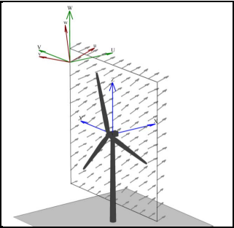
Wind Field Generation
Things to consider for input file.
Between 30 and 40 grid points.
One grid point should be at 0,0​.
Grid height and grid width should be at least 10% larger than diameter.
+1 should be added to number of grids in input file to complete the grid.
Example Wind Field from TurbSim
[1]
Saurabh Jha - 770271

Slide 6
Wind Field Generation
Wind Model Specifications for DLC 1.2.:
Turbulence Class: IEC 'A' (High turbulence intensity).
Wind Type: Normal Turbulence Model (NTM).
Simulation Duration: 600-second analysis time
UsableTime: Should be set to ‘ALL’.
Scale IEC: Should be set to ‘2’, in order simulation has right mean and standard deviaton.
TimeStep: Should be at least 2 times of the highest eigenfrequency, 5-10 times are better.
Saurabh Jha - 770271

Slide 7
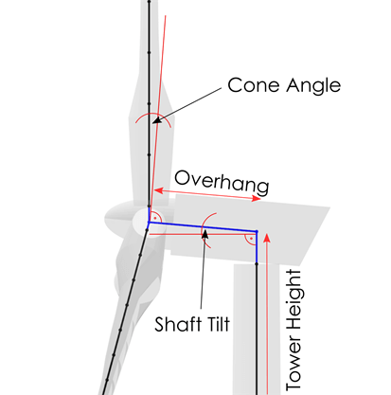
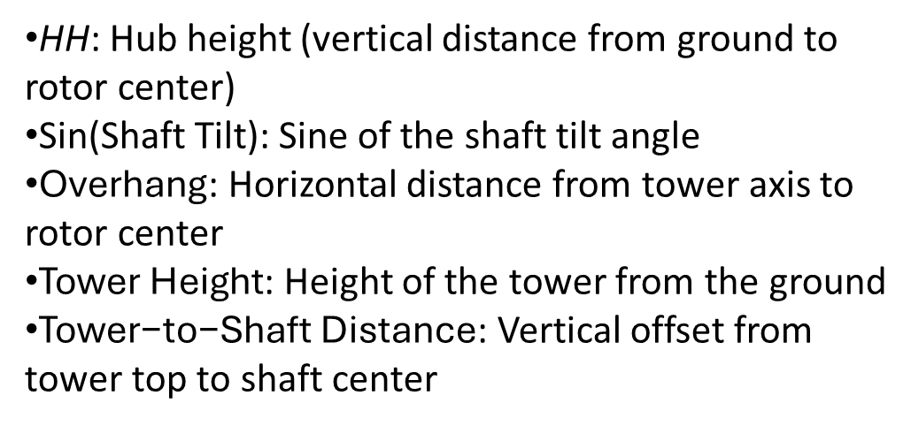
Calculation for Hub Height
Important for OpenFAST and Turbsim Input file.
HH=sin(Shaft Tilt)×Overhang+Tower Height+Tower to-Shaft Distance
HH: Hub height (vertical distance from ground to rotor center)
Sin(Shaft Tilt): Sine of the shaft tilt angle
$\text{Overhang}$: Horizontal distance from tower axis to rotor center
$\text{Tower} \text{Height}$: Height of the tower from the ground
$\text{Tower}\text{−}\text{to}\text{−}\text{Shaft} \text{Distance}$: Vertical offset from tower top to shaft center
[2]
Sketch from Qblade documentation
Saurabh Jha - 770271

Slide 8
Simulation Settings
30 seconds of simulation.
DLC 1.2 wind fields with average of 8 m/s, 10 m/s and 12 m/s.
Only enabled Rotor DOF and First fore-aft tower bending-mode DOF.
Set initial conditions of rotor speed, pitch angle, tower top positions. So that turbine starts in steady state.
Running only feedback controller, no Lidar-assisted controller.
Saurabh Jha - 770271

Slide 9
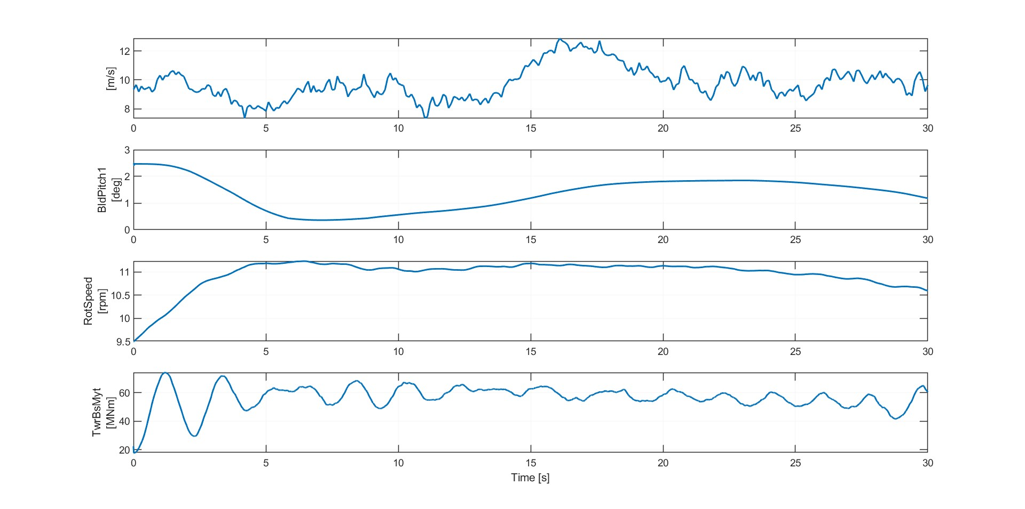
Result 1
Simulation results for IEA 3.4 MW with feedback control. 8 m/s wind field for DLC 1.2
Saurabh Jha - 770271

Slide 10
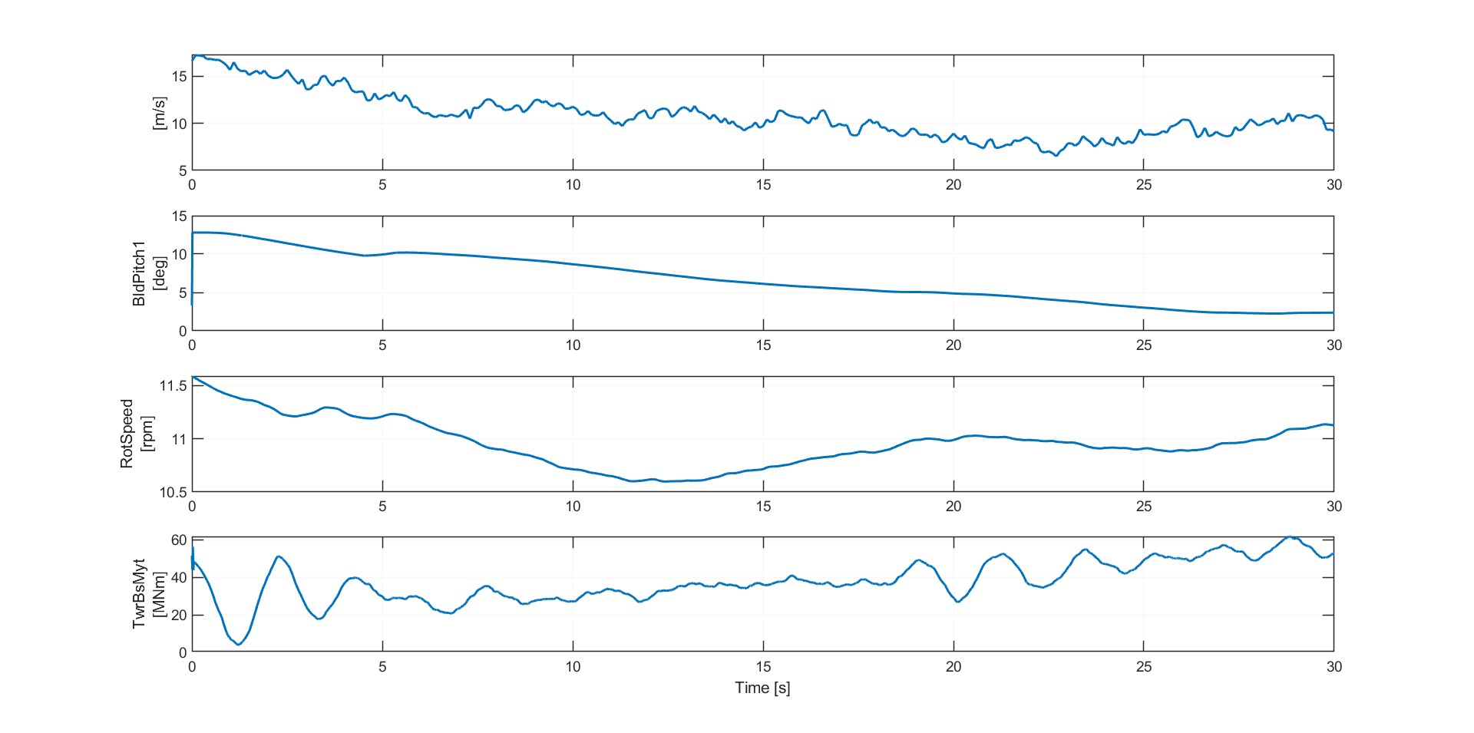
Result 2
Simulation results for IEA 3.4 MW with feedback control. 10 m/s wind field for DLC 1.2
Saurabh Jha - 770271

Slide 11
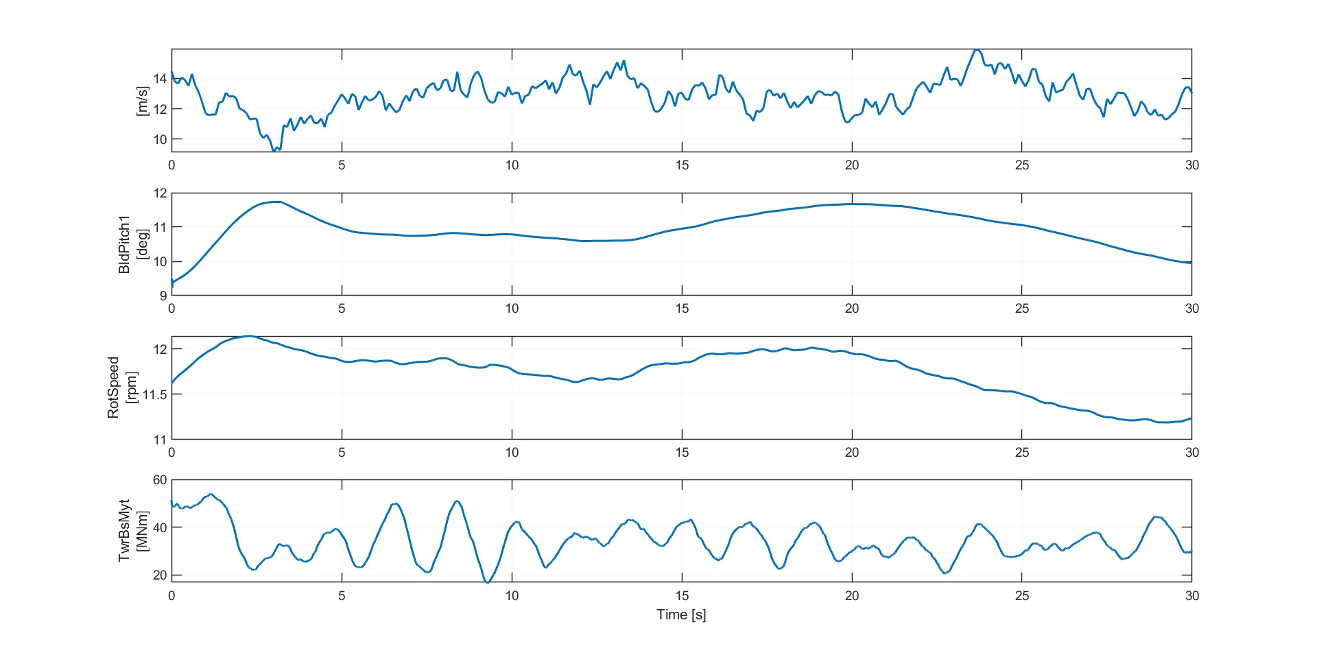
Result 3
Simulation results for IEA 3.4 MW with feedback control. 12 m/s wind field for DLC 1.2
Saurabh Jha - 770271

Slide 12
Conclusion
Successfully generated wind fields.
Run examples of DLC 1.2 simulation.
Next week:
Run full DLC 1.2 simulations, with different seeds, wind speeds and longer simulation time.
Understand and apply cost calculation for controllers.
Saurabh Jha - 770271

Slide 13
Bibliography – Feedback Controller
[1] “TurbSim User’s Guide v2.00.00,” Nrel.gov, 2025. https://www.nrel.gov/docs/libraries/wind-docs/turbsim_v2-00-pdf.pdf?sfvrsn=5a0a30f8_1
[2] “Aerodynamic Turbine Design — QBlade Documentation 2.0.6.4 documentation,” docs.qblade.org. https://docs.qblade.org/src/user/turbine/aerodynamic.html
Saurabh Jha - 770271

